Slide 1
Data Extraction From Single Source into Multiple Targets
Milind Parab

Slide 2
Pre-Requisites for the Demo.
Load Master Data.
Create Flat File Transaction Data.
Create Info Objects.
SMID : SIDxx
PID: PIDxx
Quantity: QTY_xx
Sales: SREV_xx
Profit: PR_xx

Slide 3
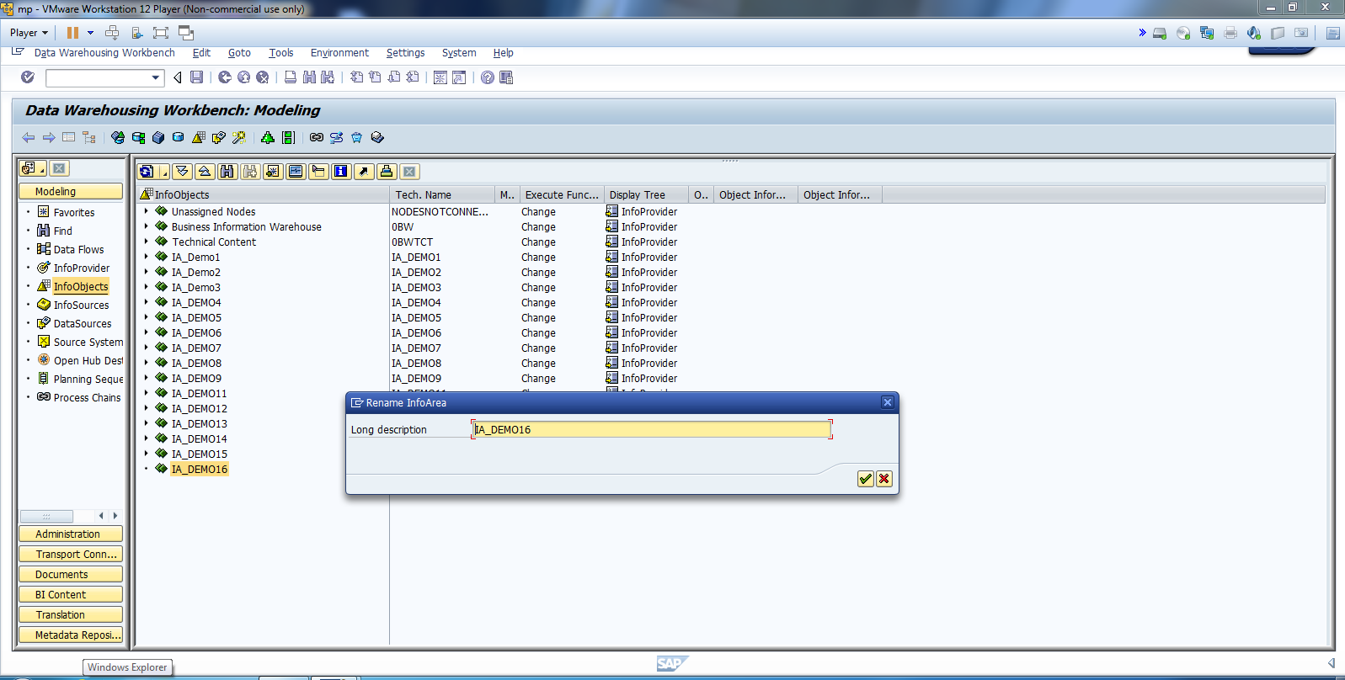
Create IA.

Slide 4
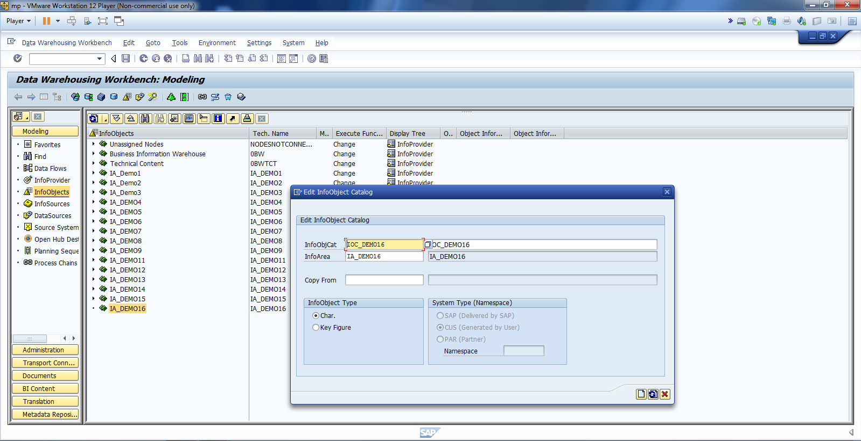
Create IOC and Activate.

Slide 5
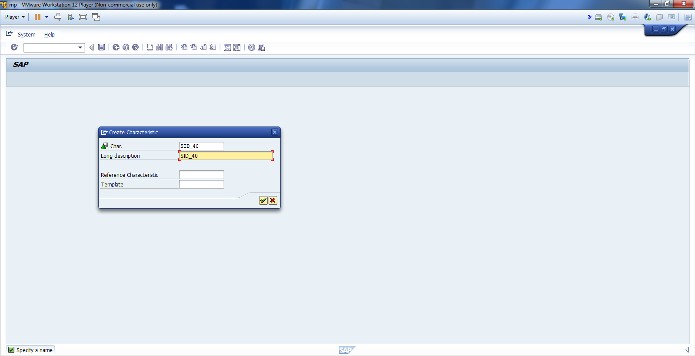
Create IO.

Slide 6
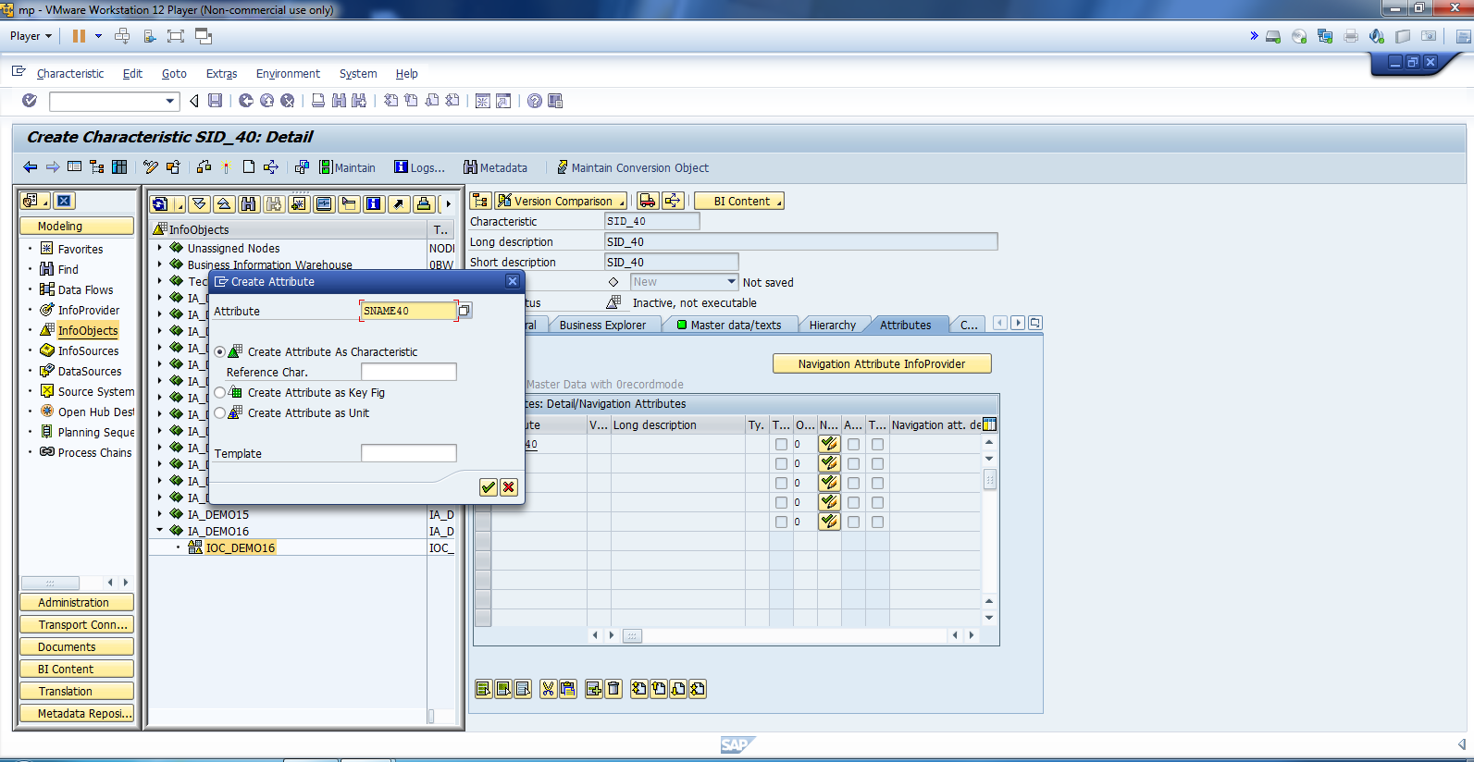
Create Attributes.

Slide 7
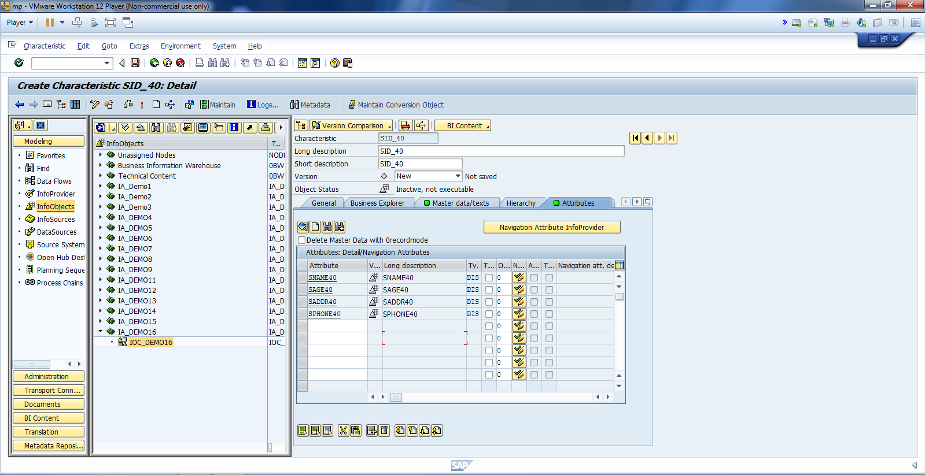
Create Attributes as shown.

Slide 8
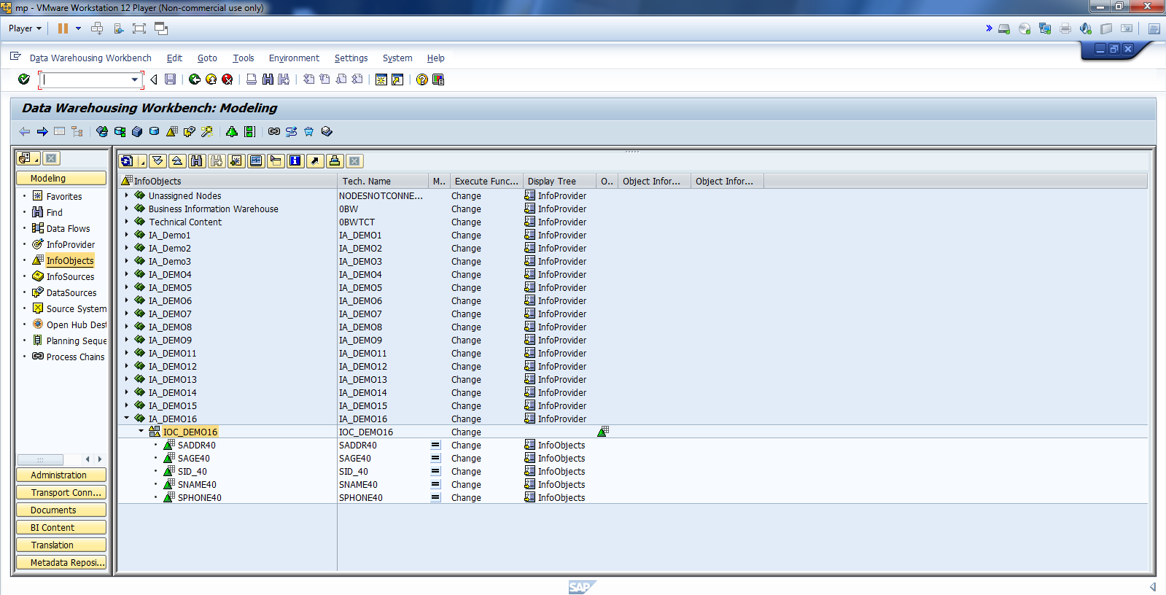
Activate IO and Attributes.

Slide 9
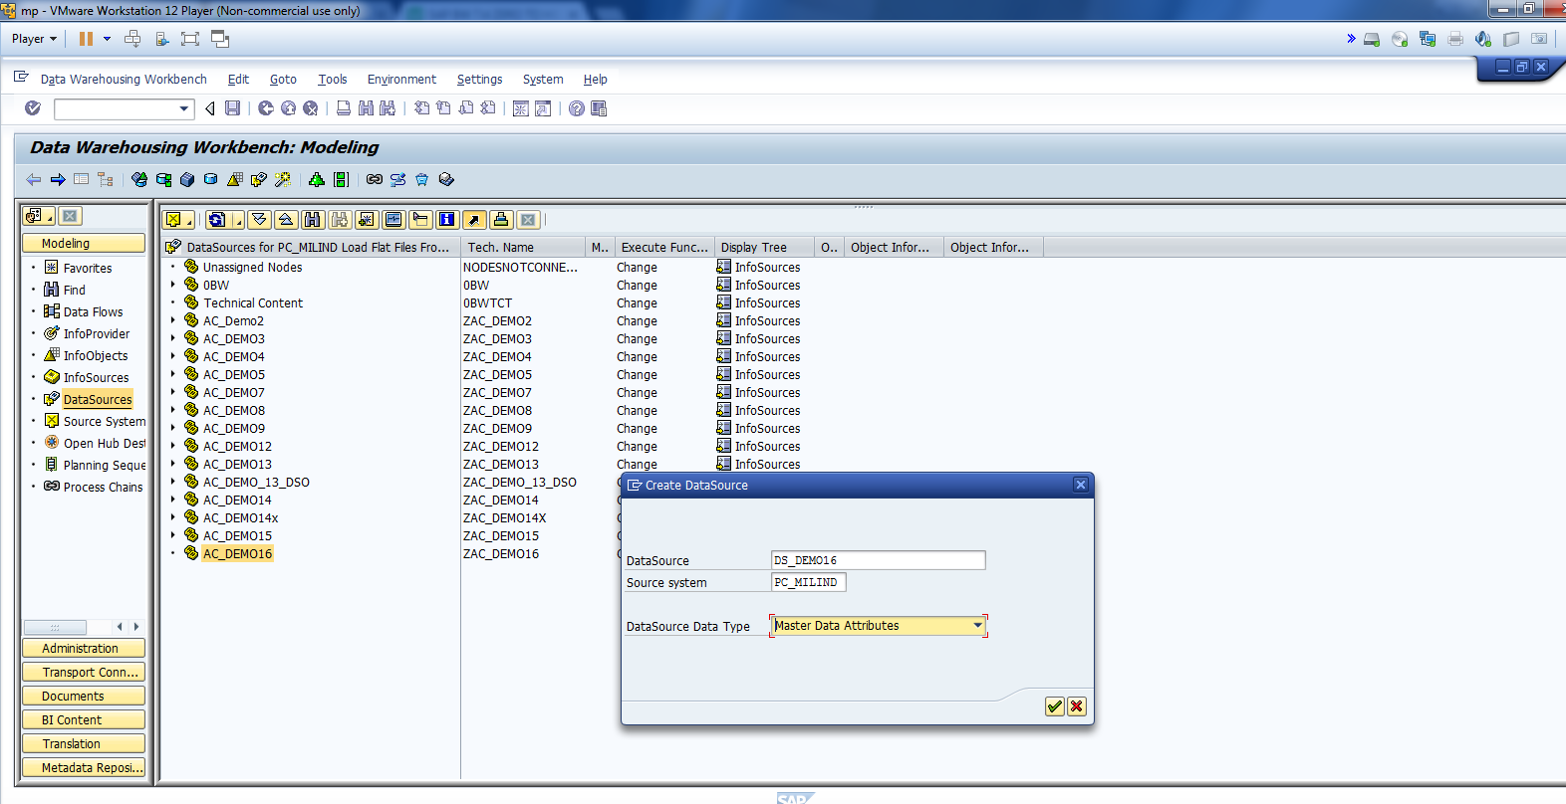
Create DS.

Slide 10
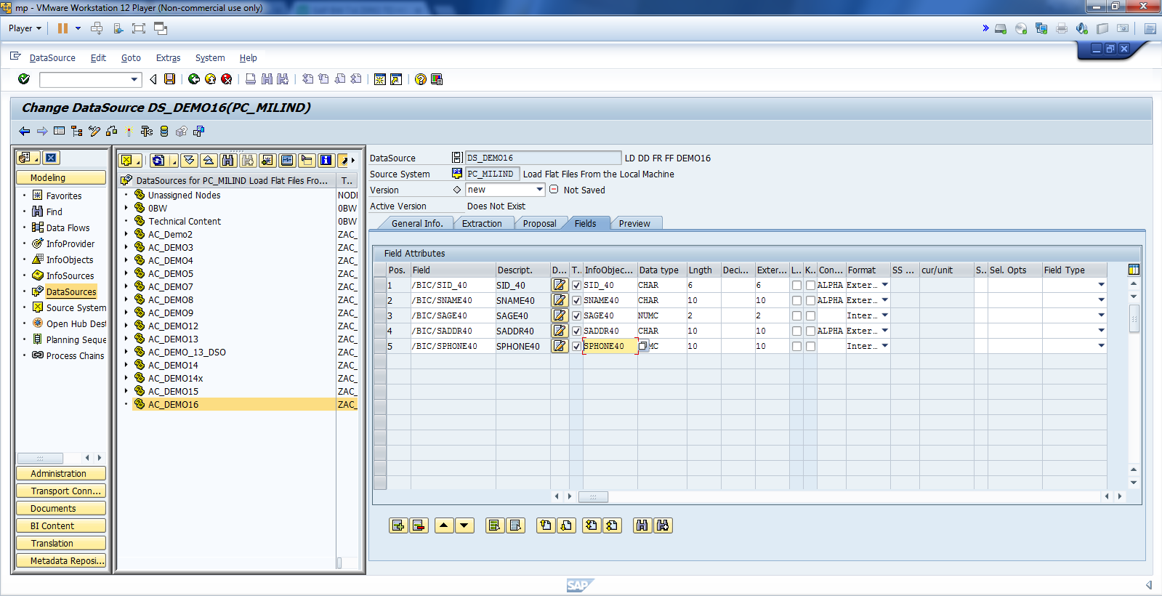
Map all Fields.

Slide 11
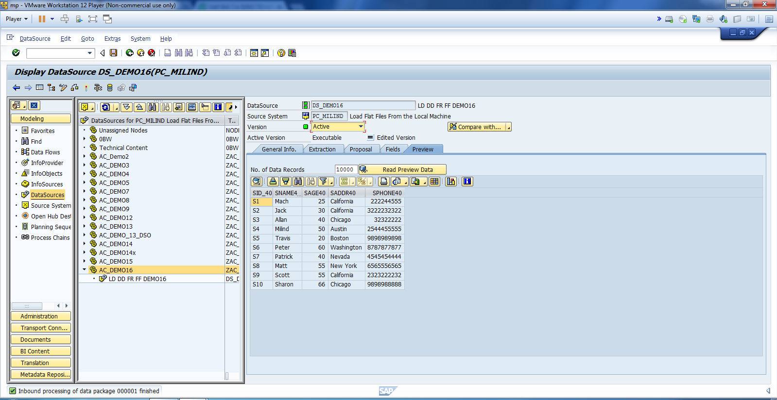
Activate DS and Read Preview Data.

Slide 12
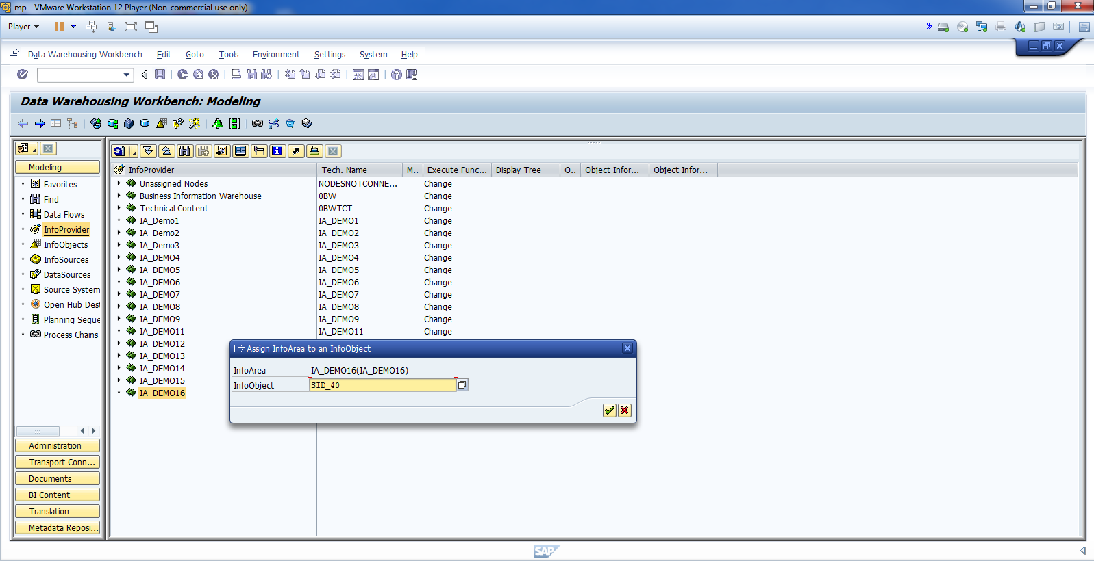
Insert Char as Info Provider.

Slide 13
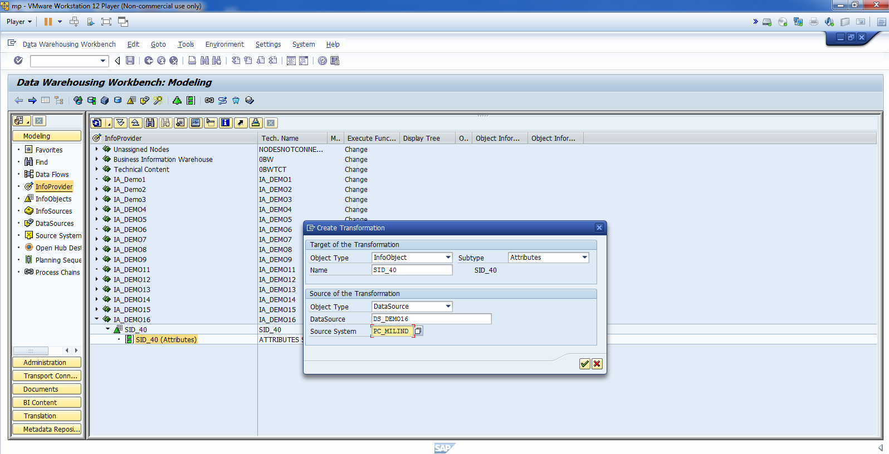
Create Transformation and Activate.

Slide 14
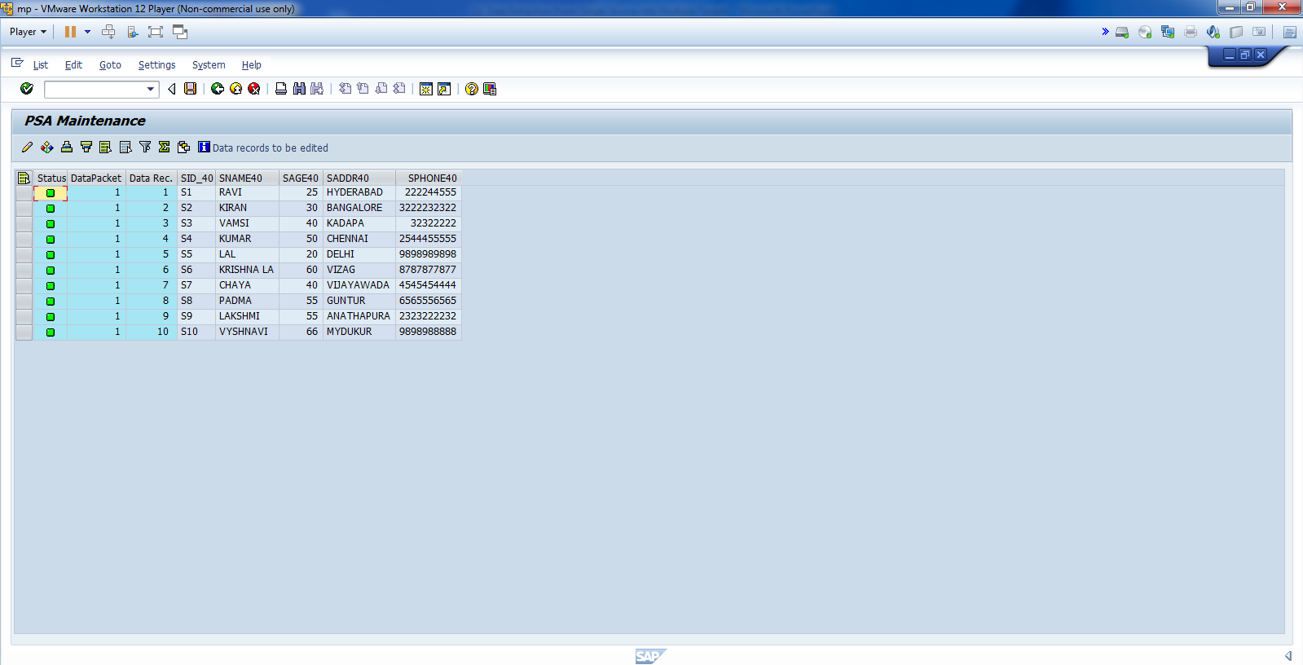
Data Stored Successfully in PSA.

Slide 15
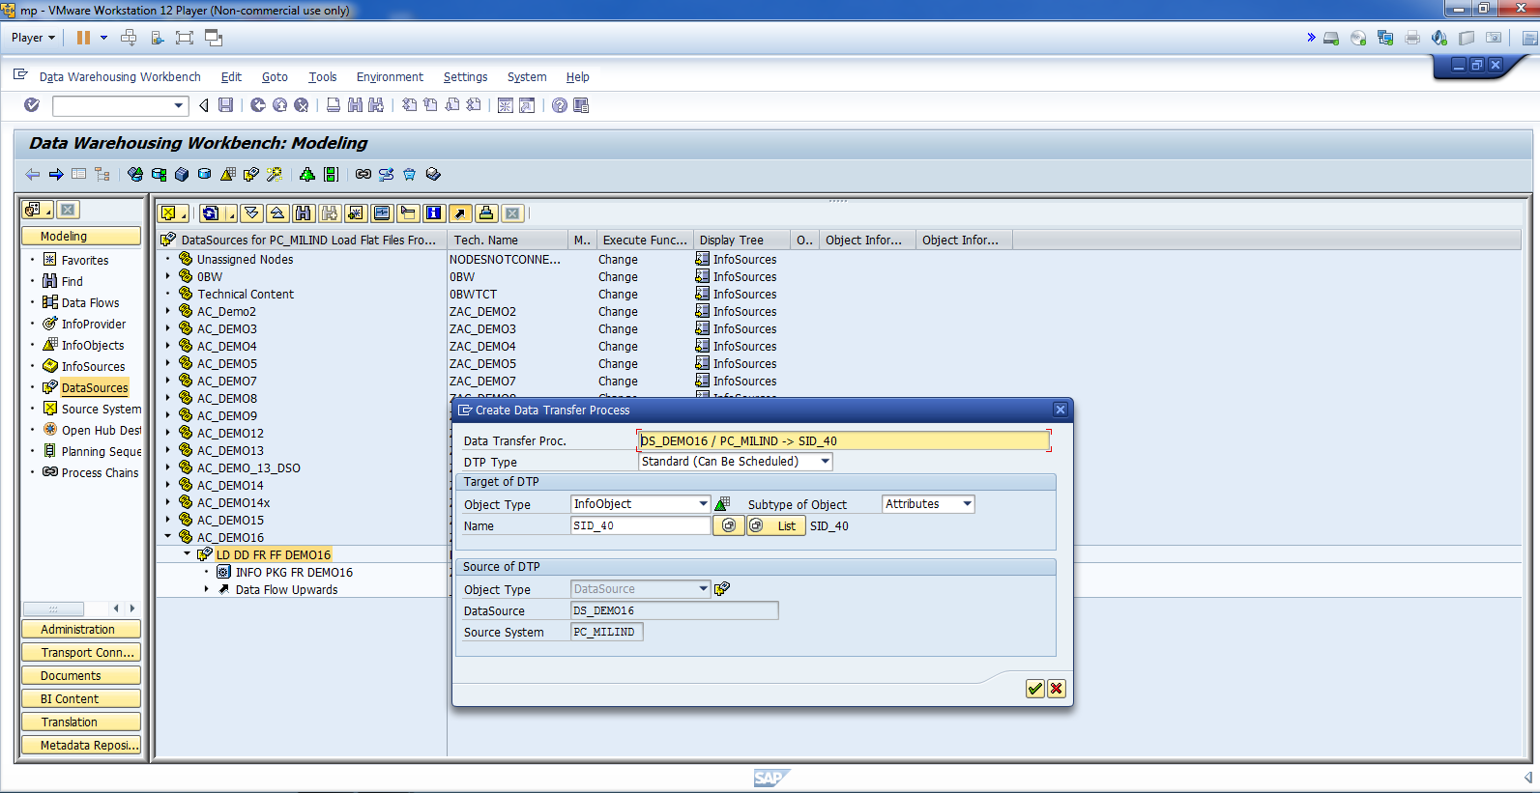
Create DTP.

Slide 16
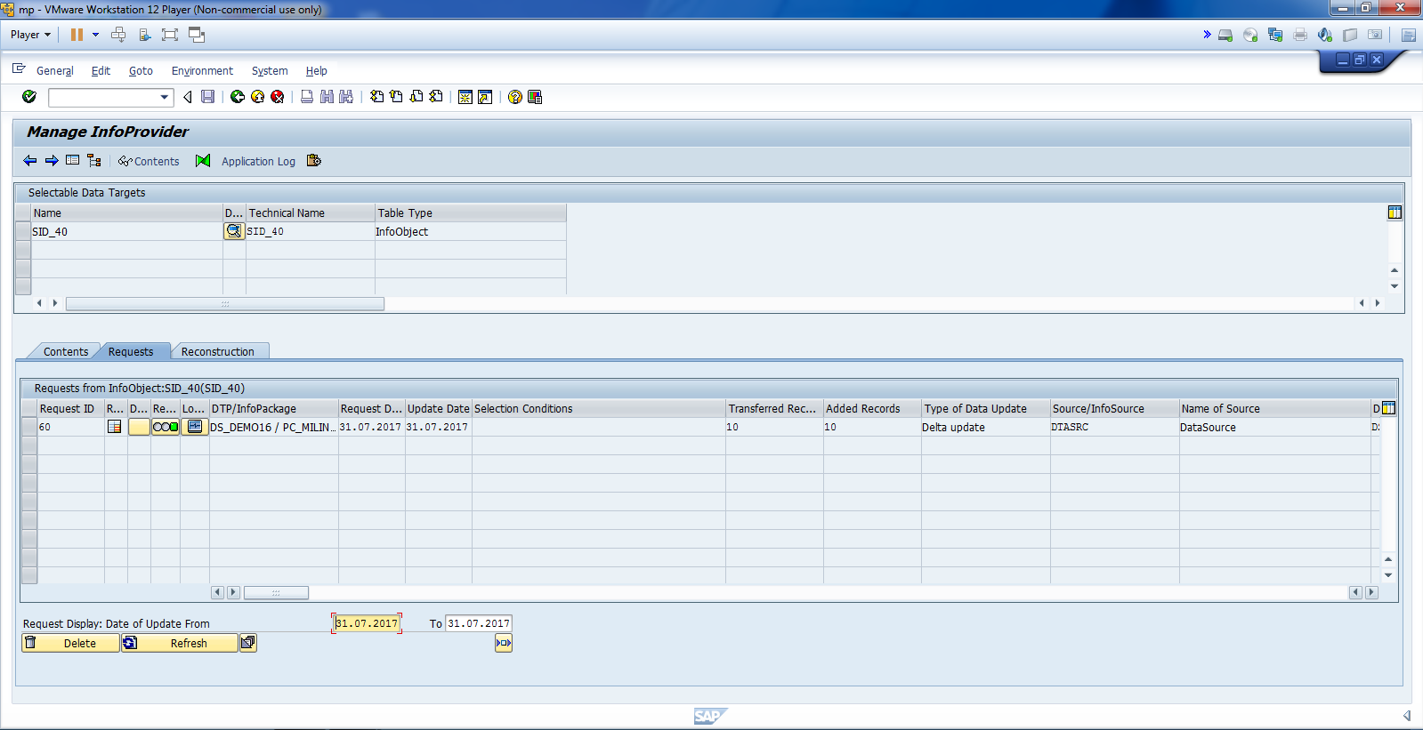
Data loaded Successfully in BW.

Slide 17
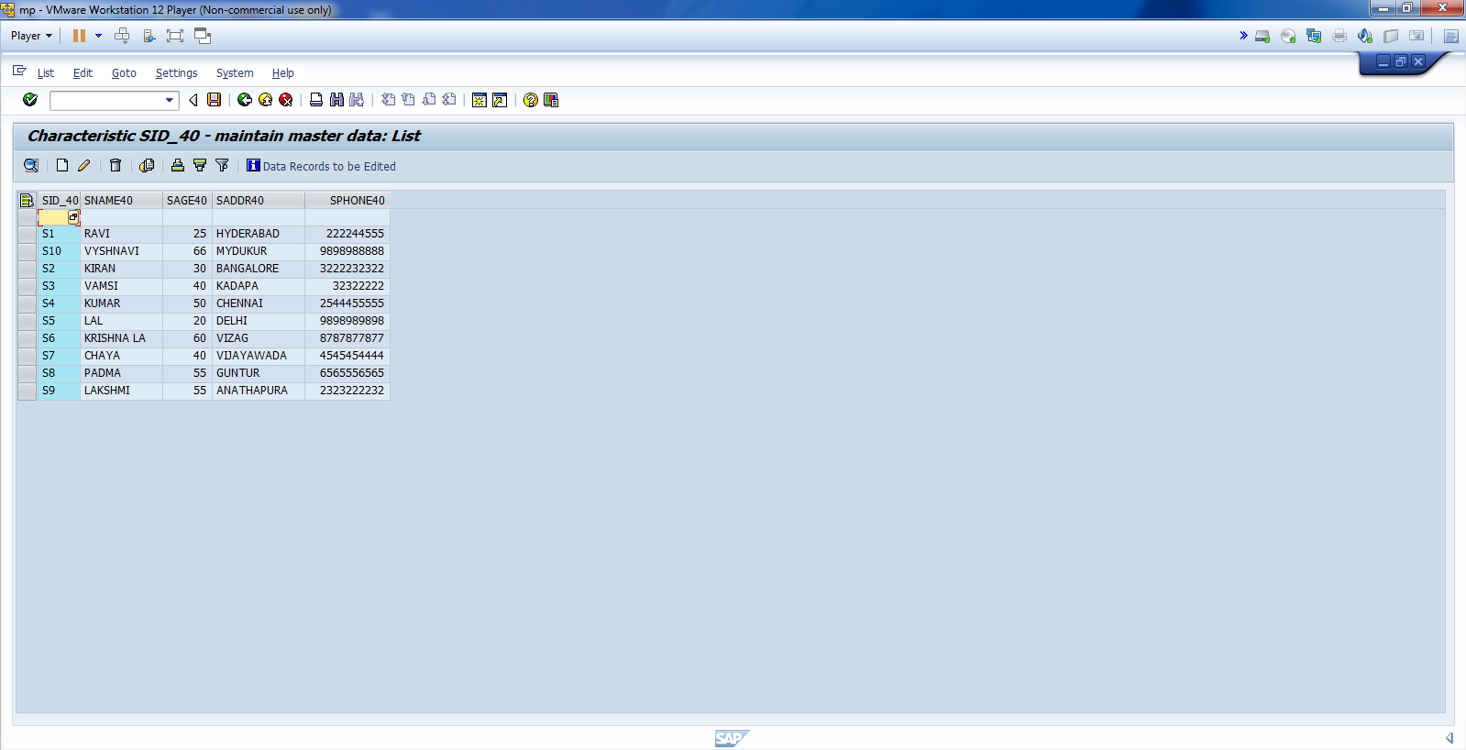
Cont.

Slide 18
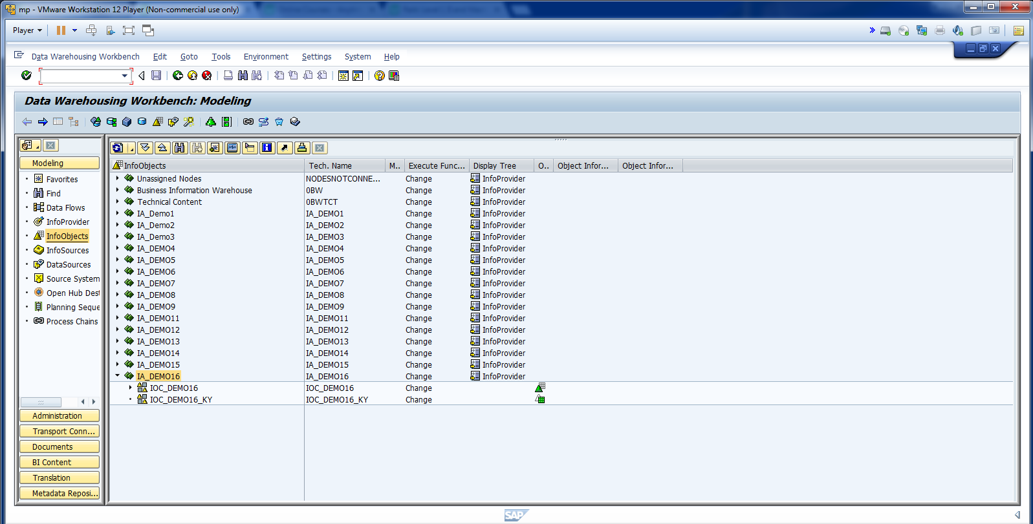
Create IOC for Key.

Slide 19
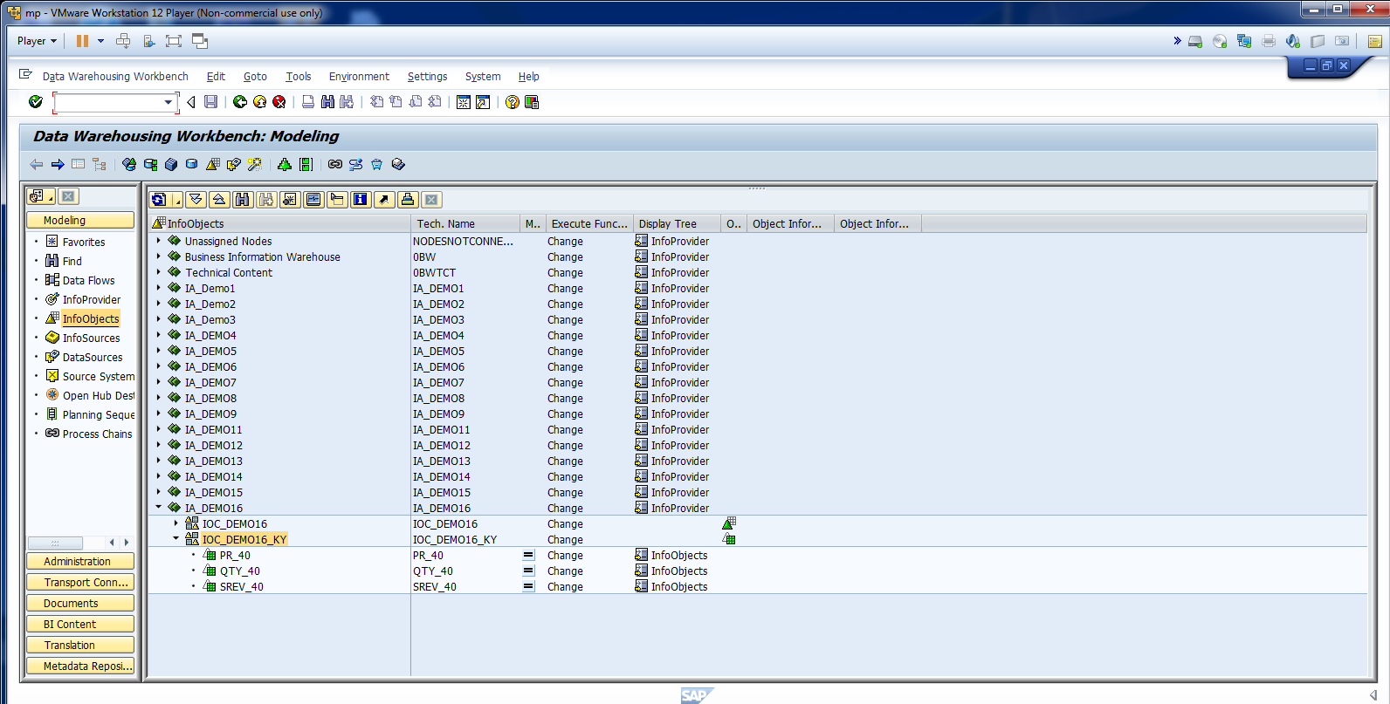
Cont.

Slide 20
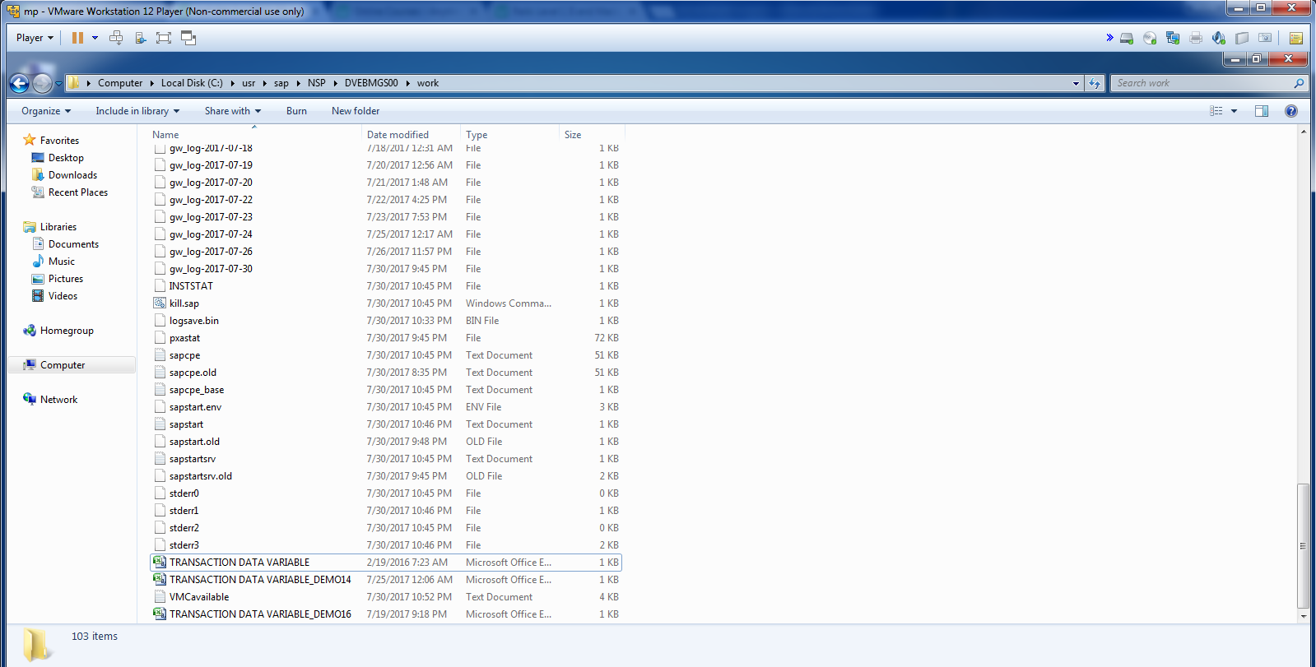
Place FF Transaction Data.

Slide 21
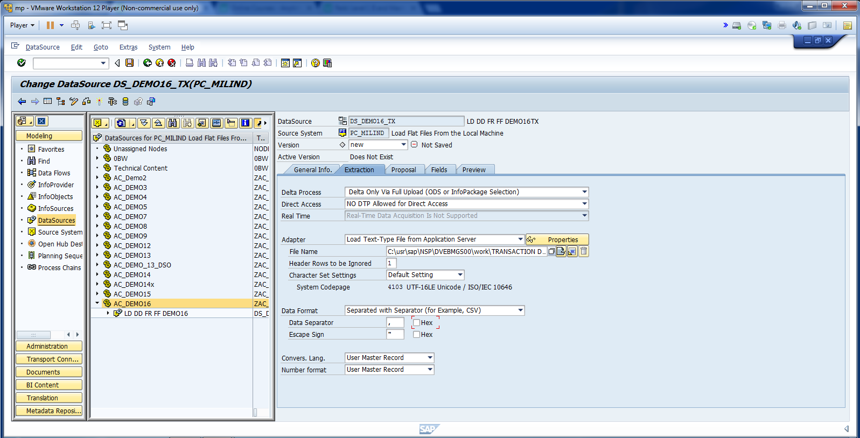
Update the info for DS.

Slide 22
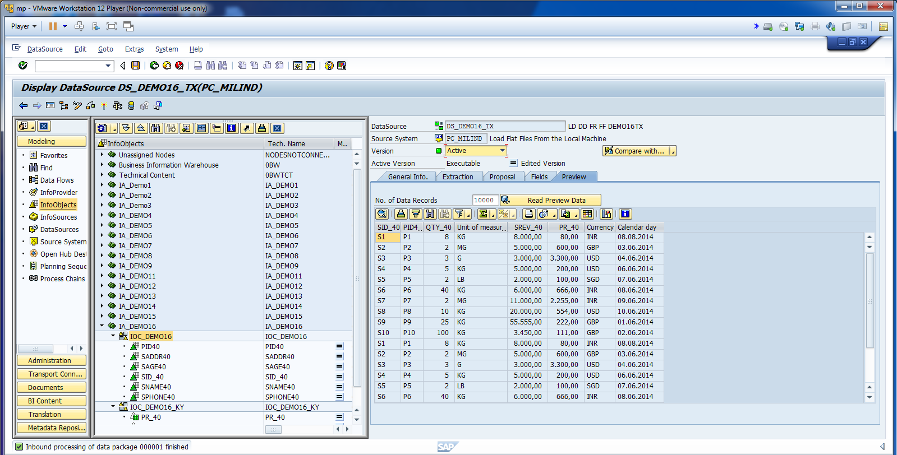
Activate DS.

Slide 23
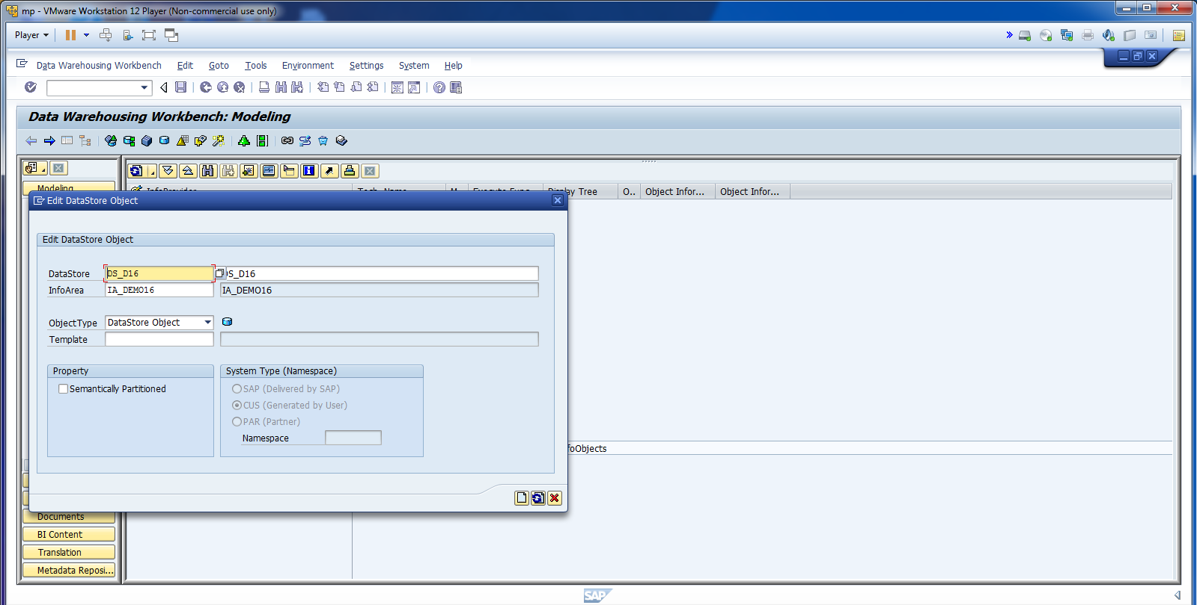
Now, Create DSO.

Slide 24
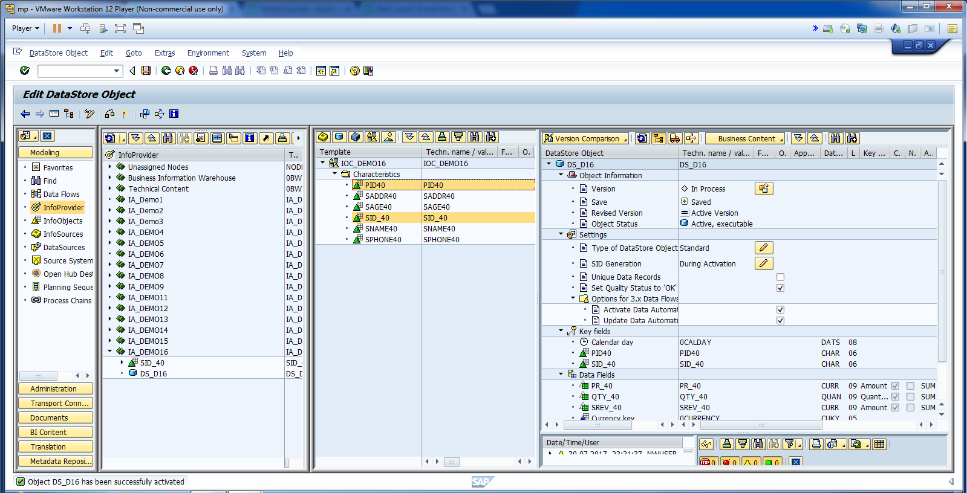
Activate DSO.

Slide 25
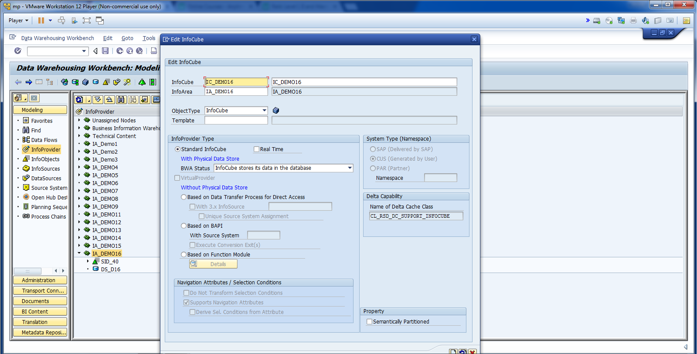
Now, Create InfoCube.

Slide 26
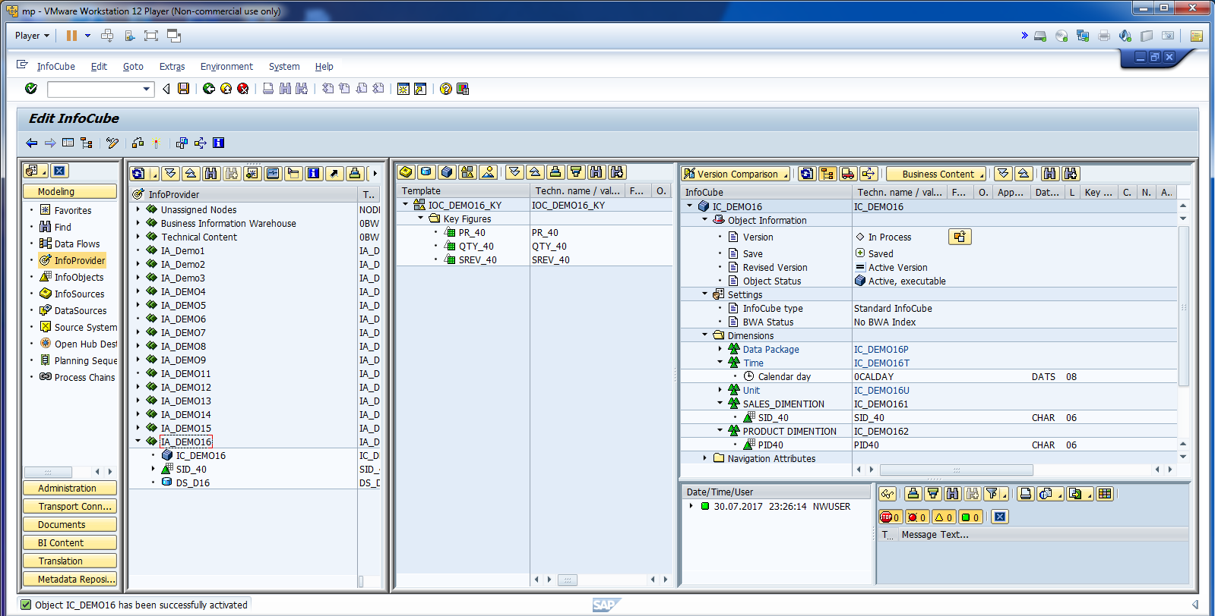
Activate InfoCube.

Slide 27
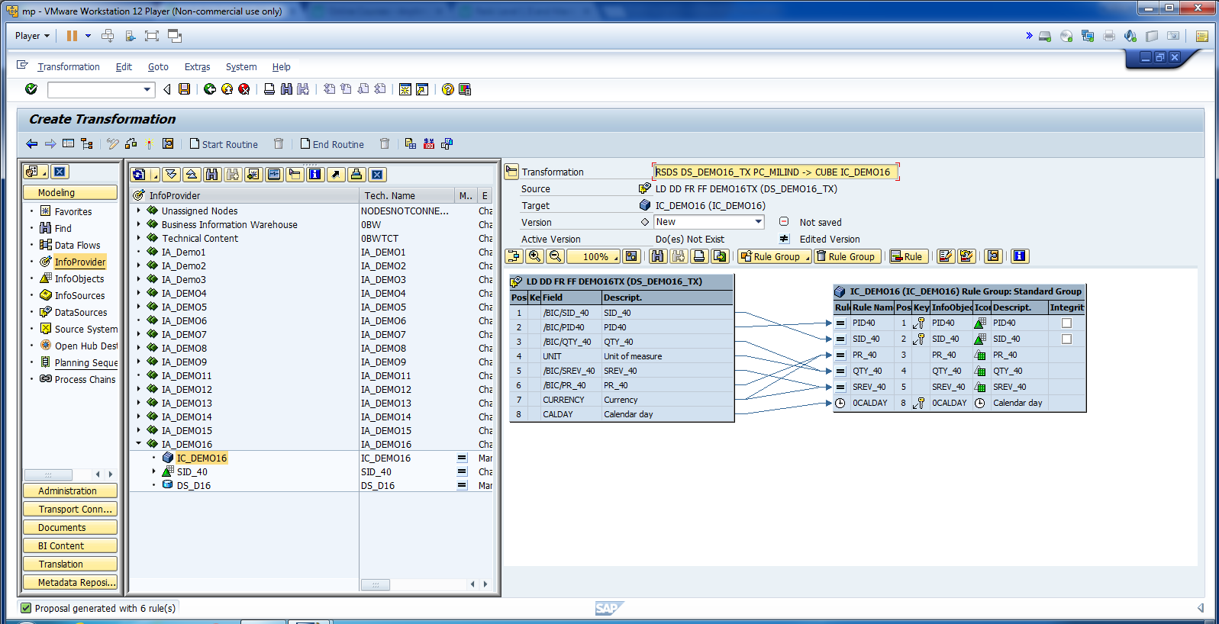
Create Transformation for ICube.

Slide 28
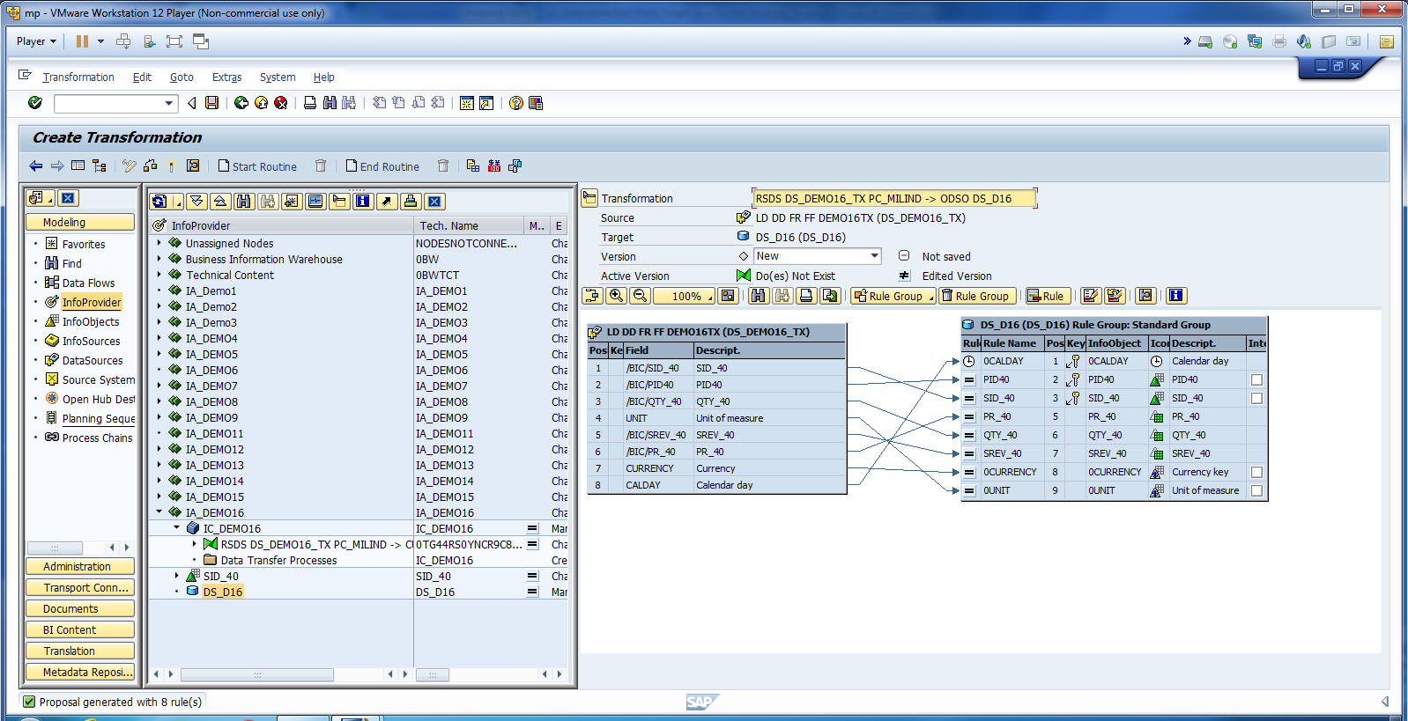
Create Transformation for DSO.

Slide 29
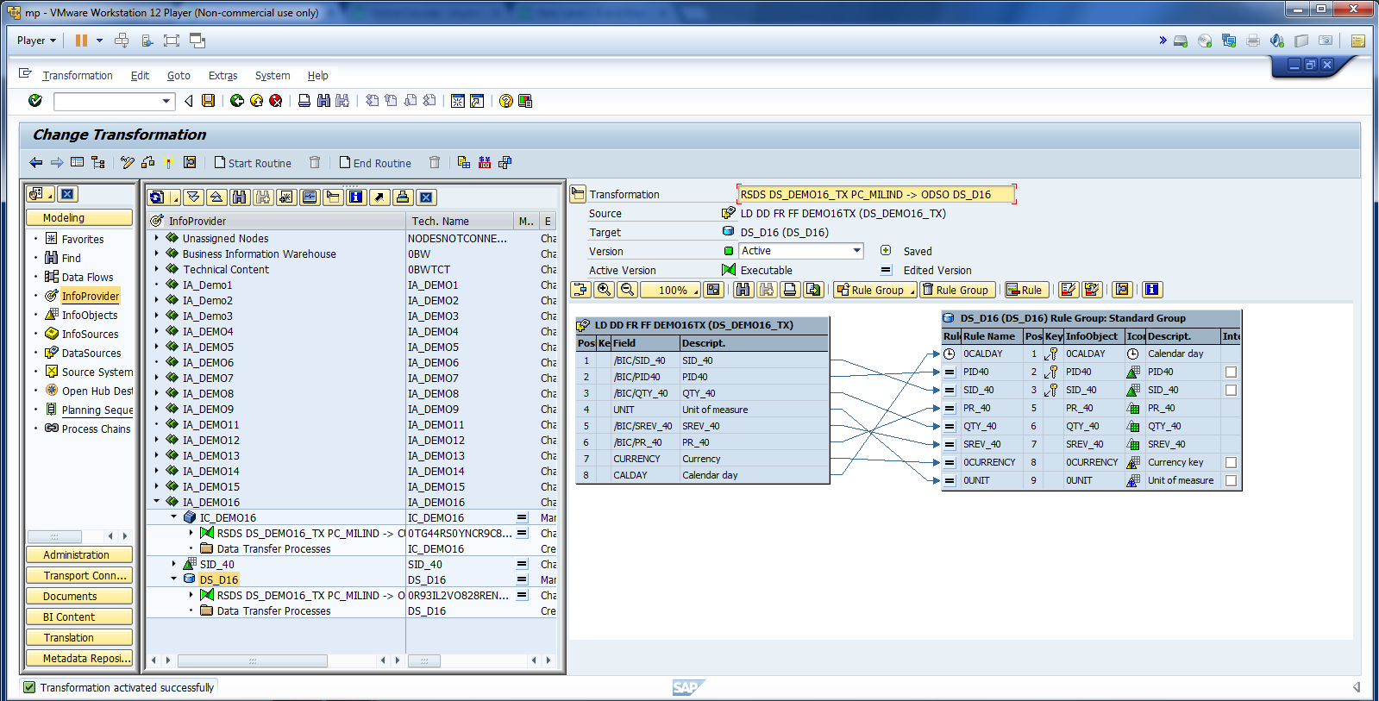
Activate Transformation.

Slide 30
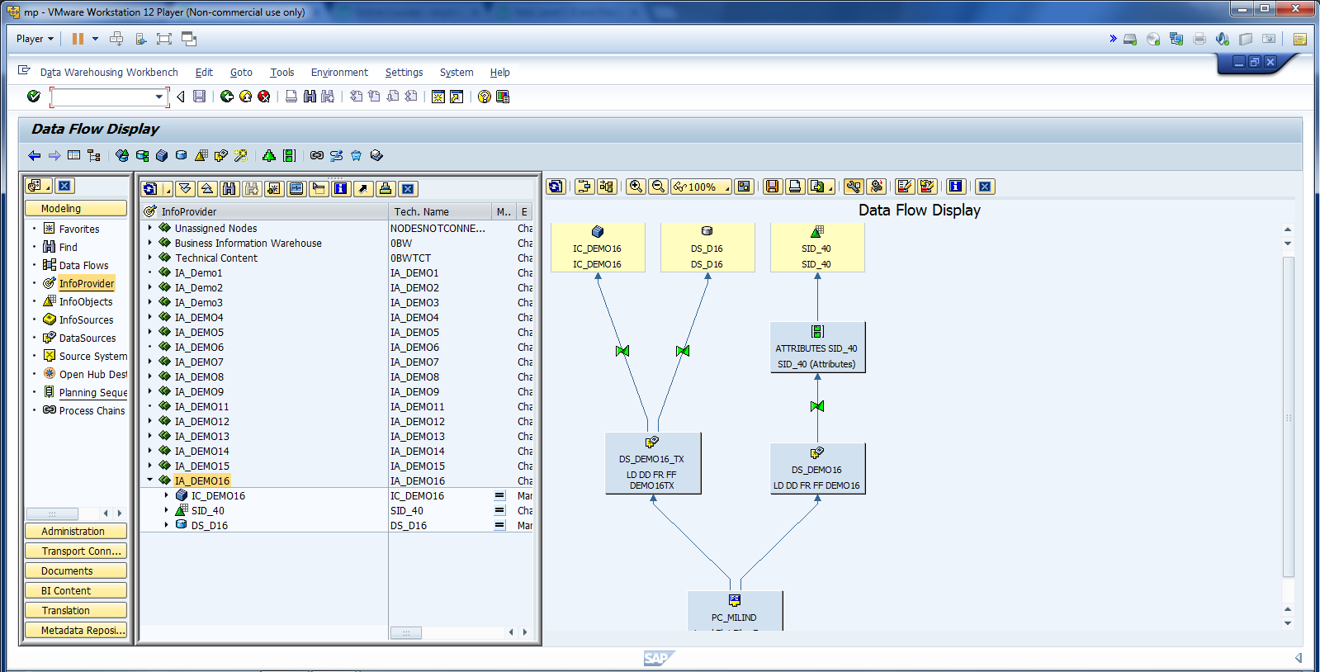
Check the Data Flow.

Slide 31
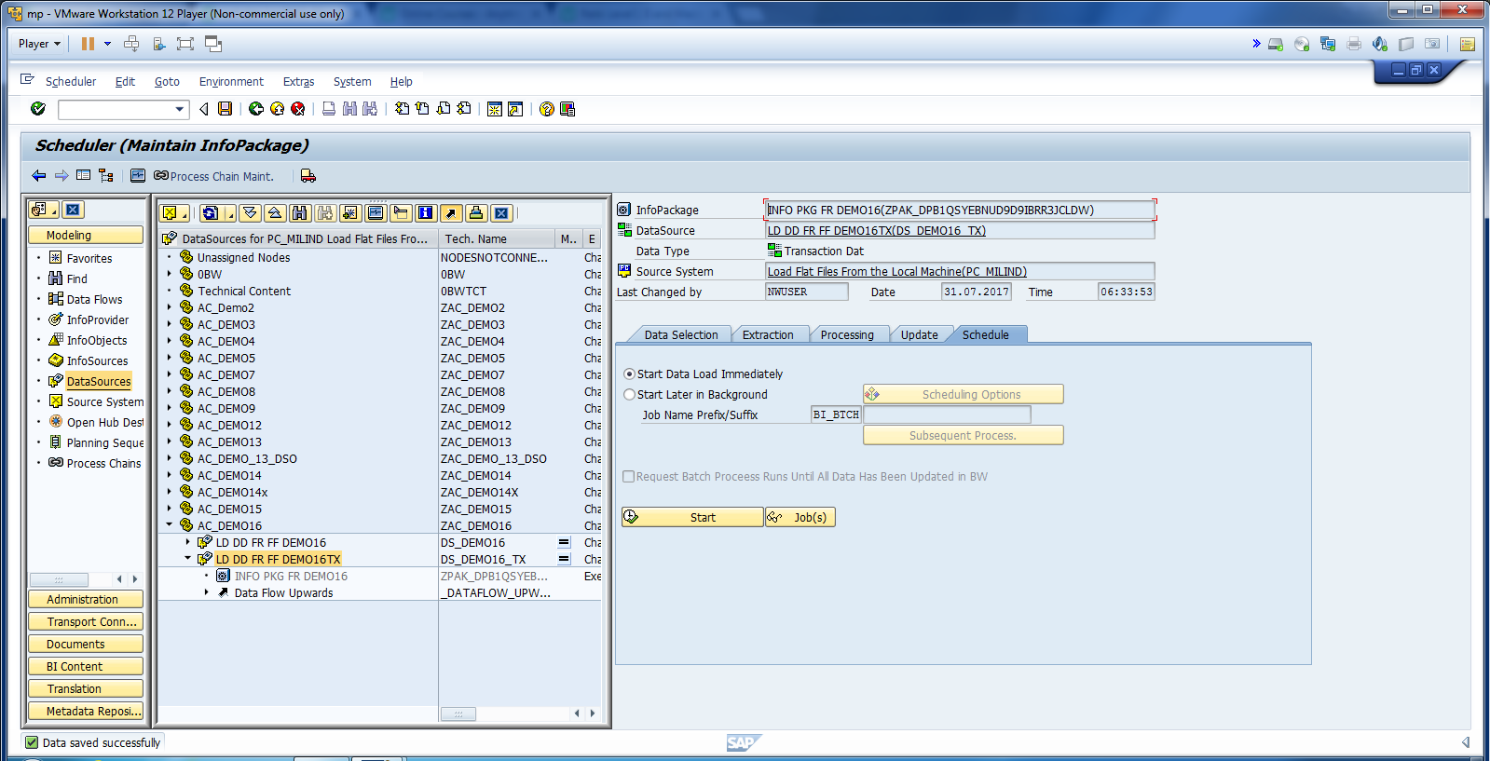
Don’t click on start. Save info package.

Slide 32
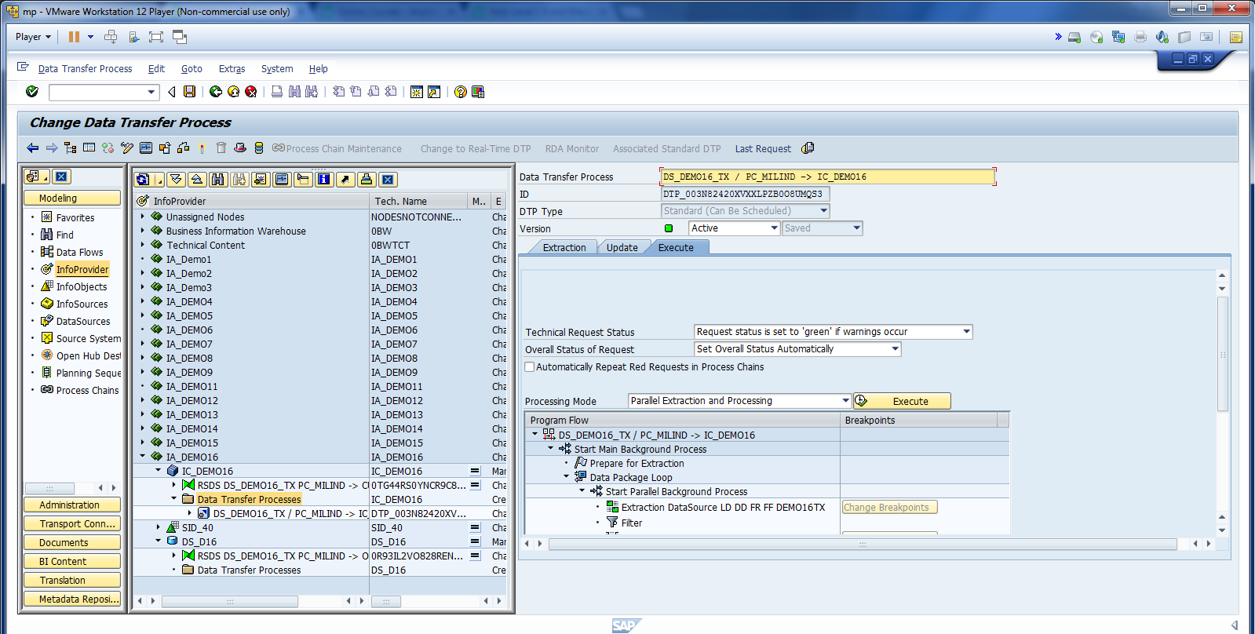
Create DTP for Info Cube and DSO. Don’t click on execute tab.

Slide 33
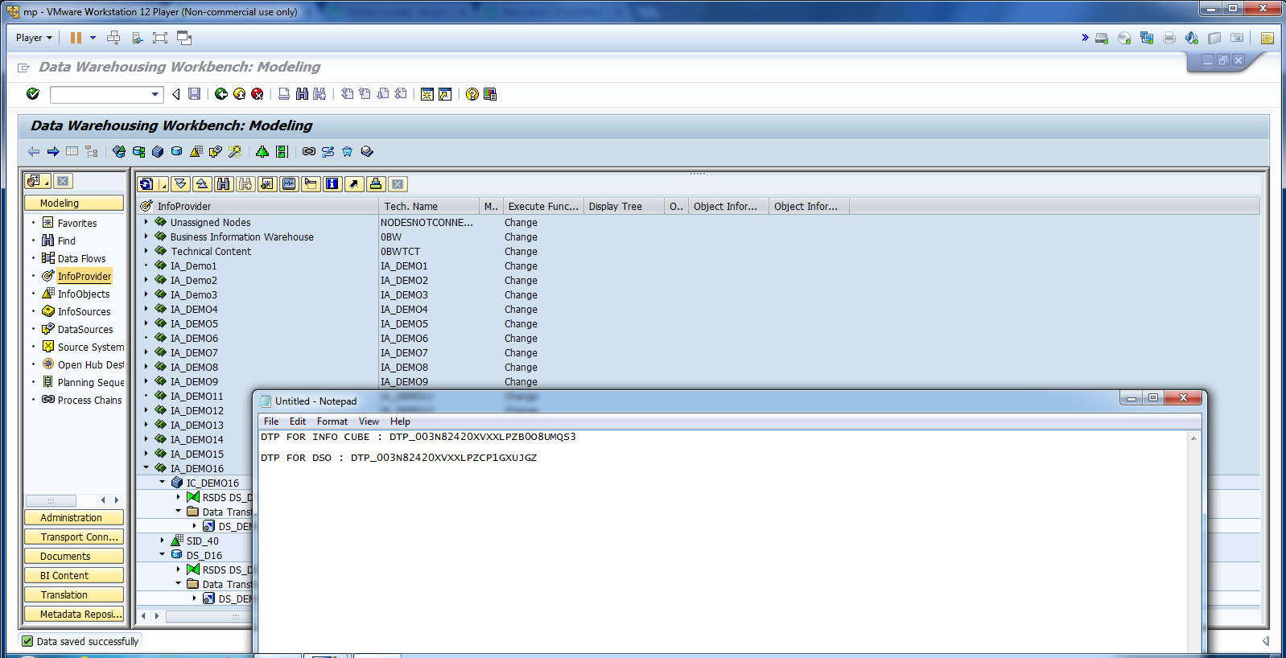
Cont.

Slide 34
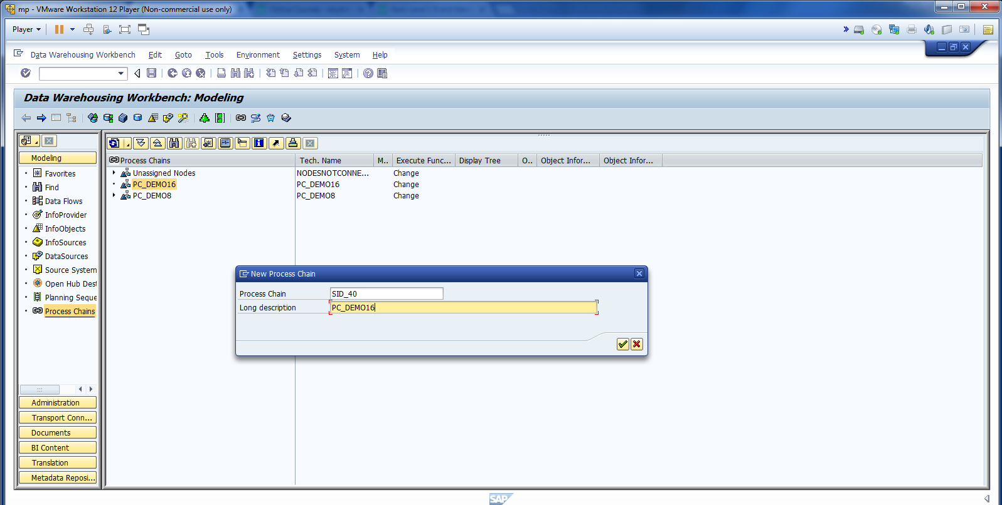
Create Start Process.

Slide 35
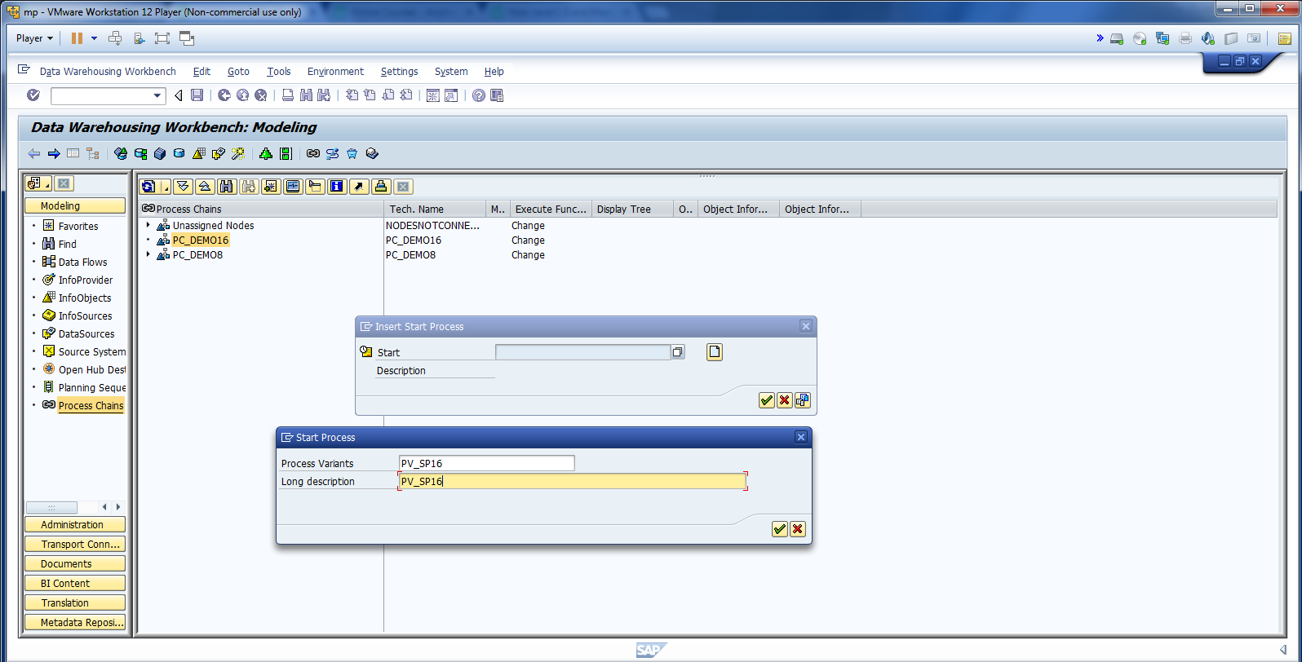
Cont.

Slide 36
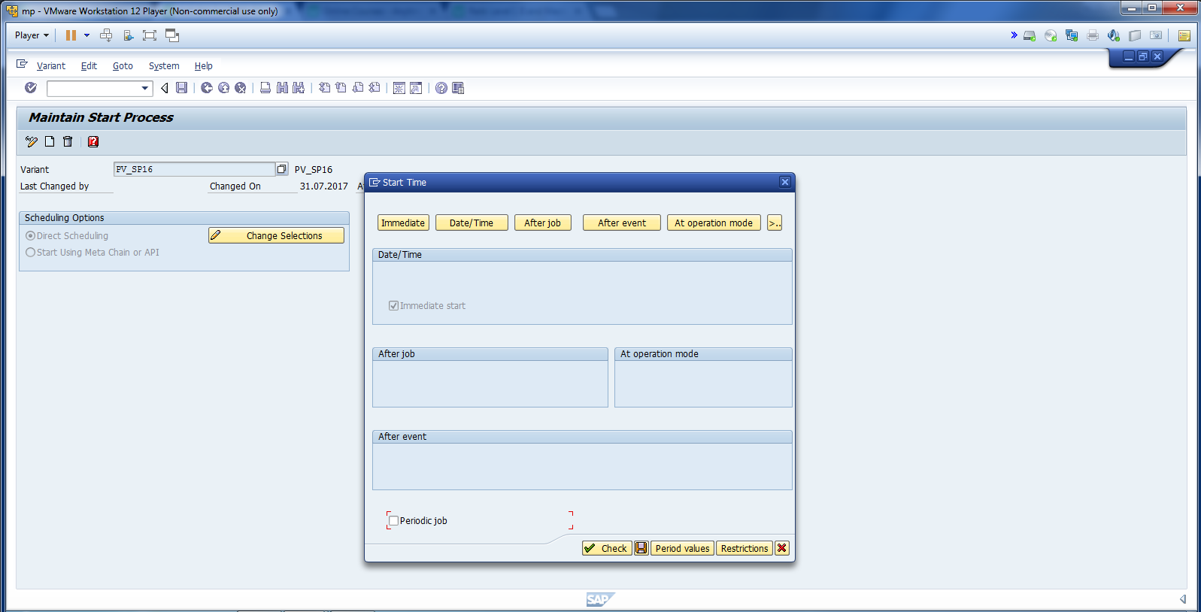
Cont.

Slide 37
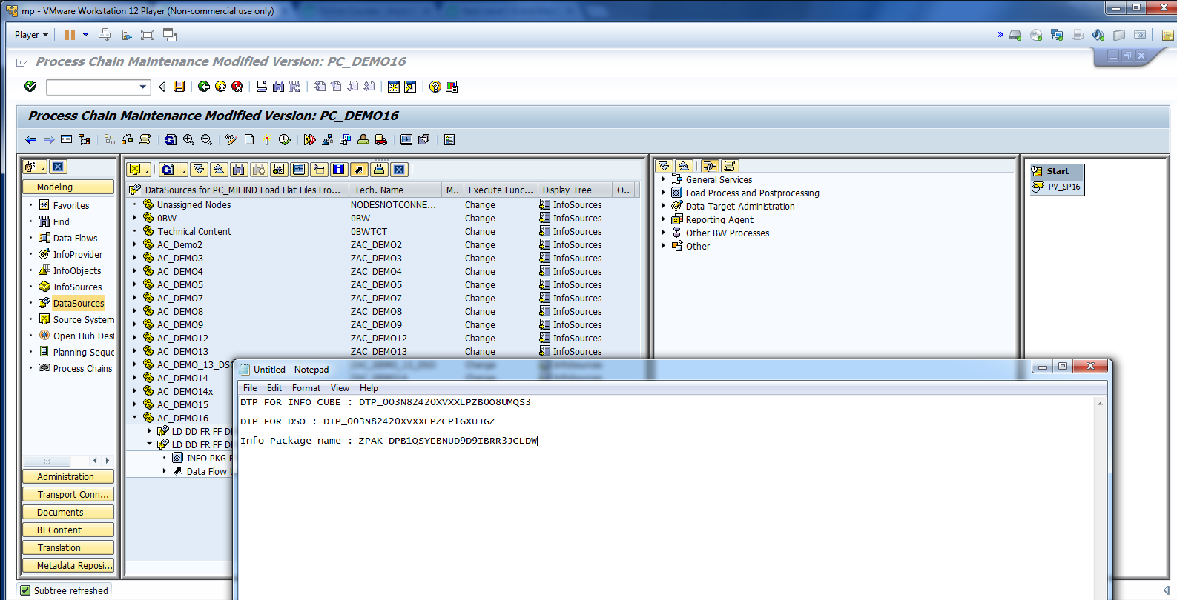
Cont.

Slide 38
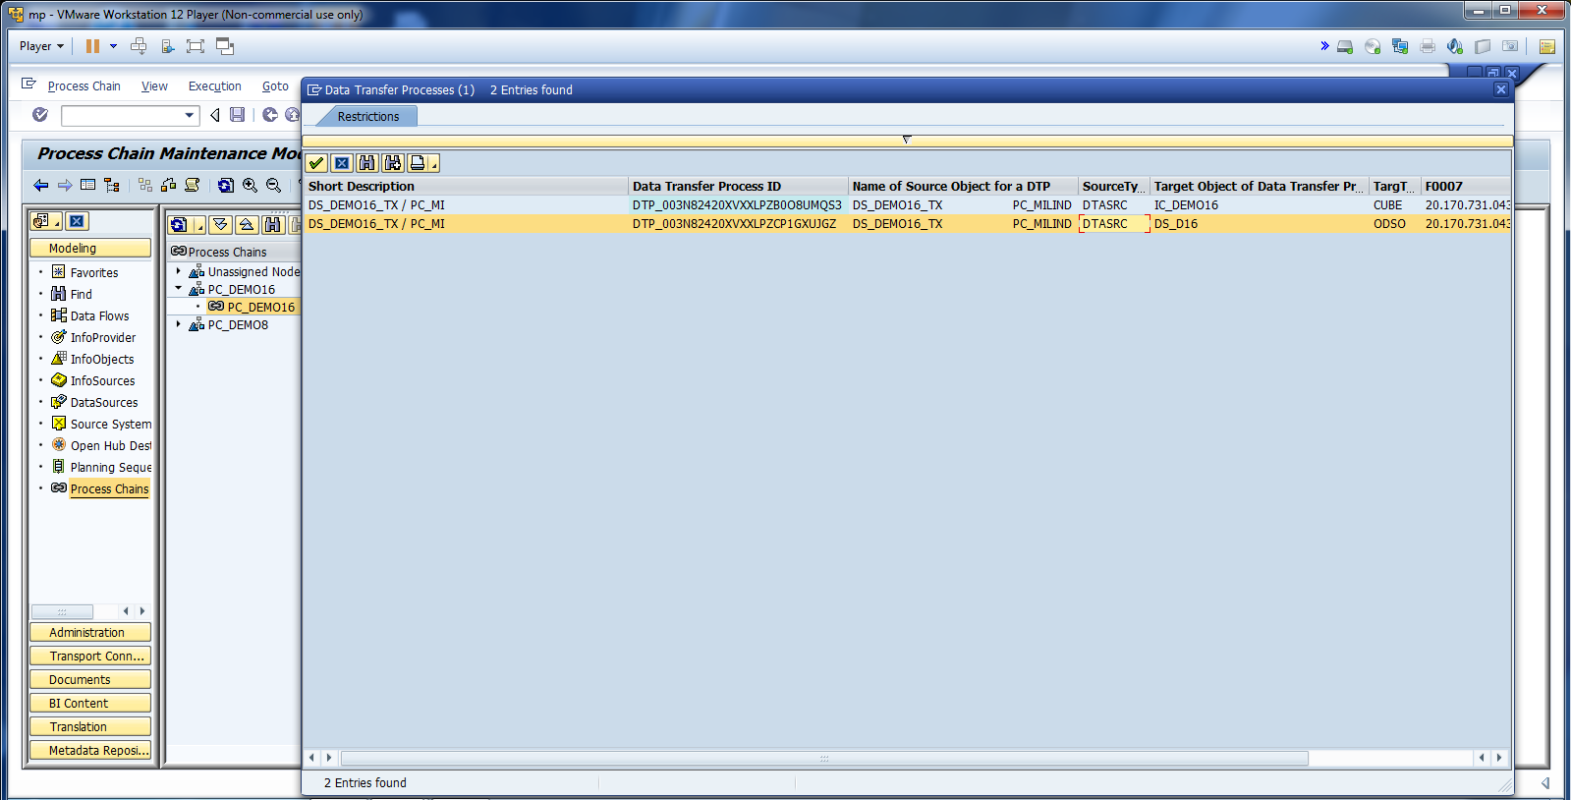
Cont.

Slide 39
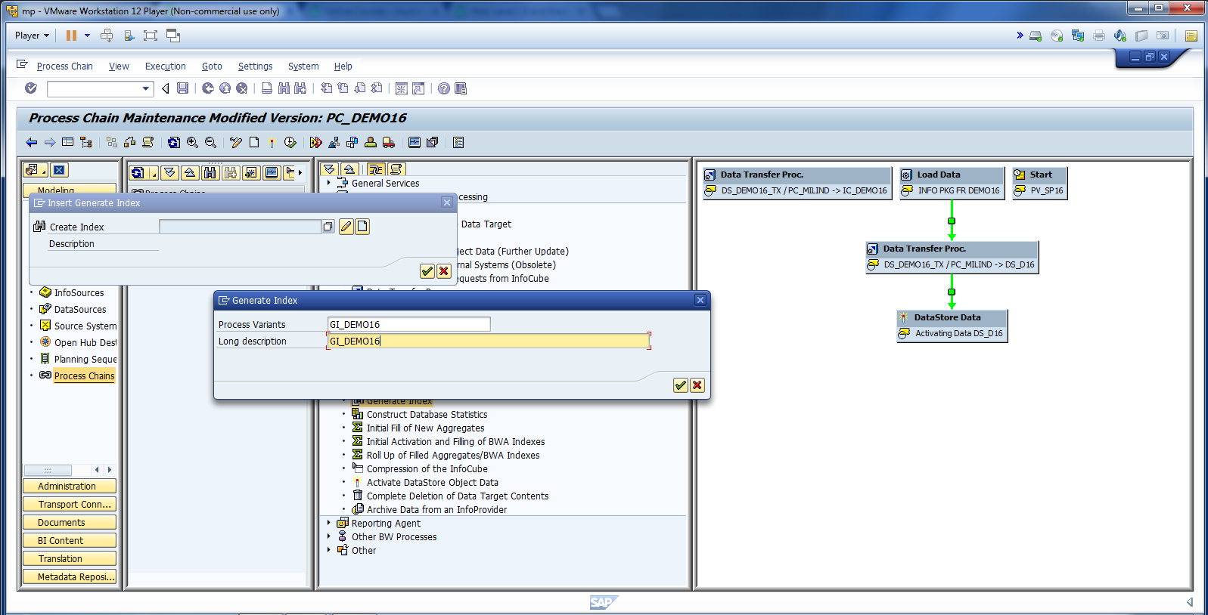
Generate Index.

Slide 40
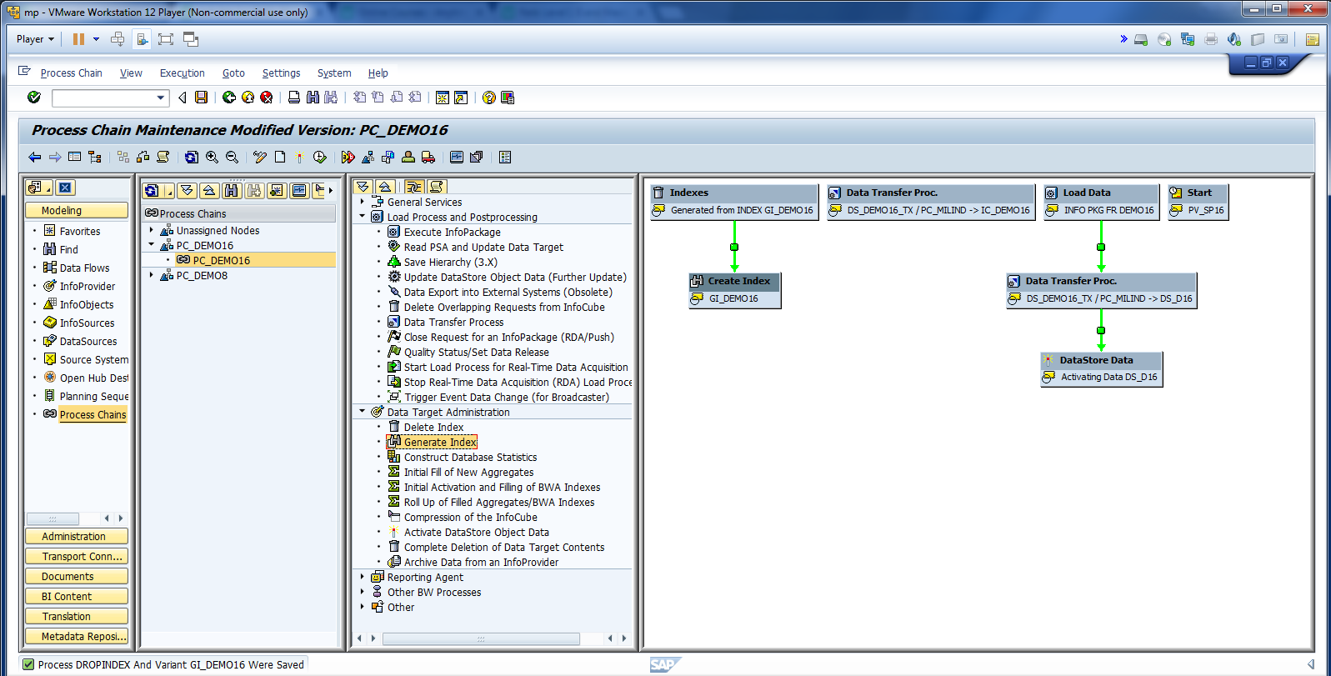
Cont.

Slide 41
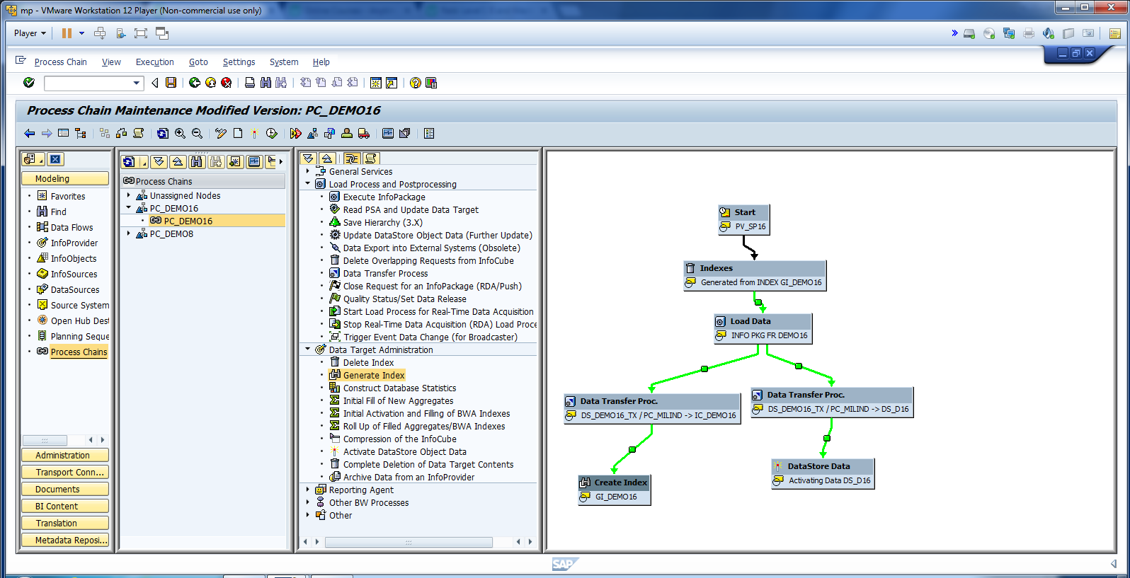
Re-arrange the process.

Slide 42
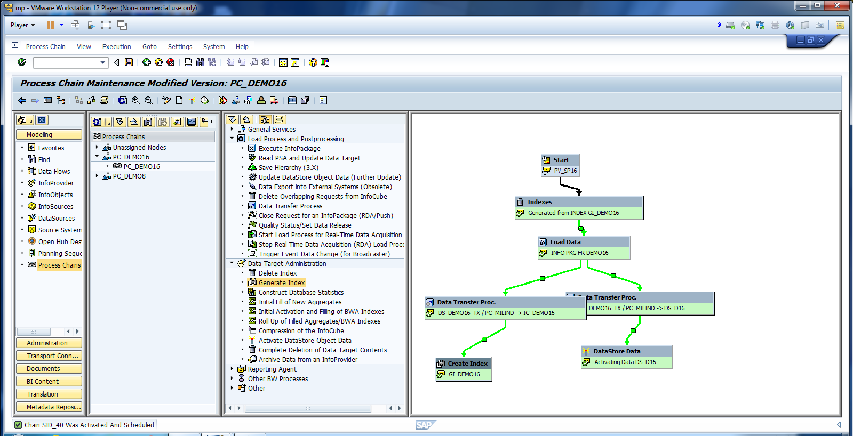
Activate and Hit schedule.

Slide 43
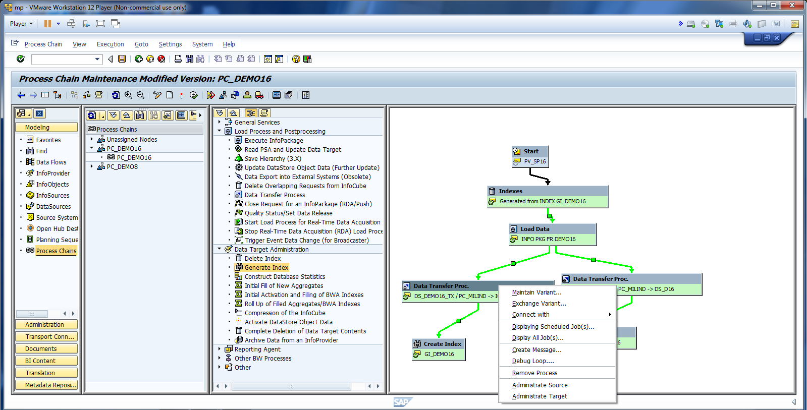
Click on Administrator Data Target to see if data has been loaded to Info Cube.

Slide 44
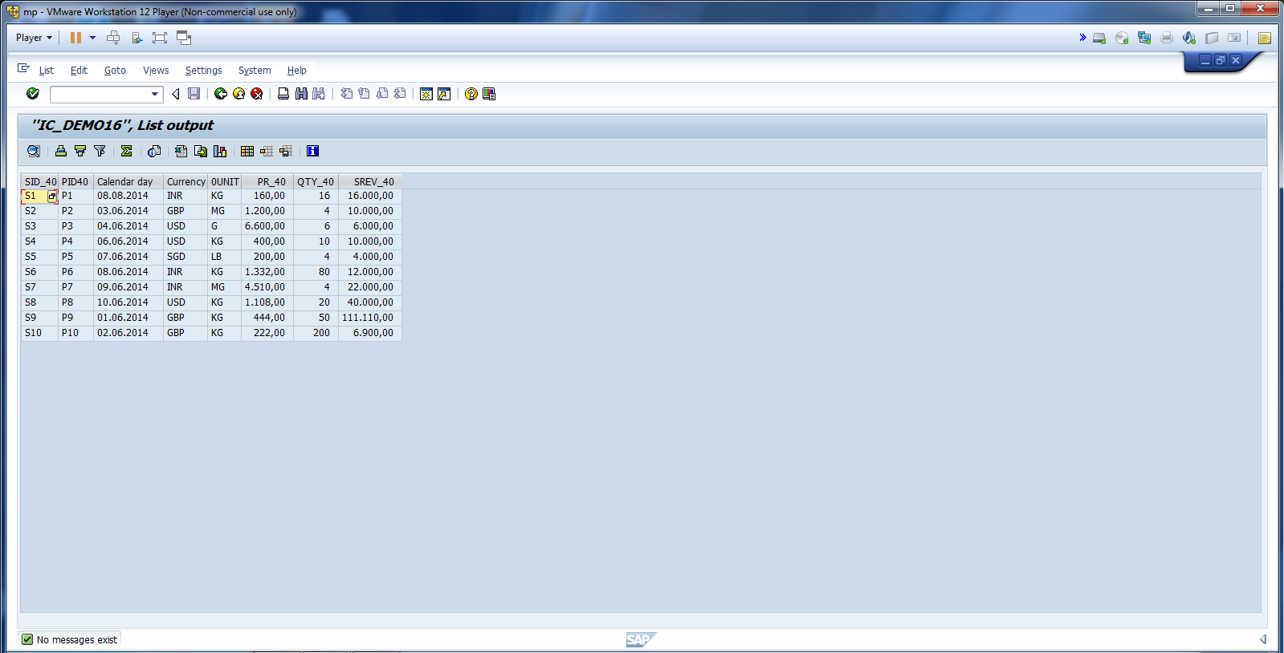
Data loaded in Info Cube Successfully.

Slide 45
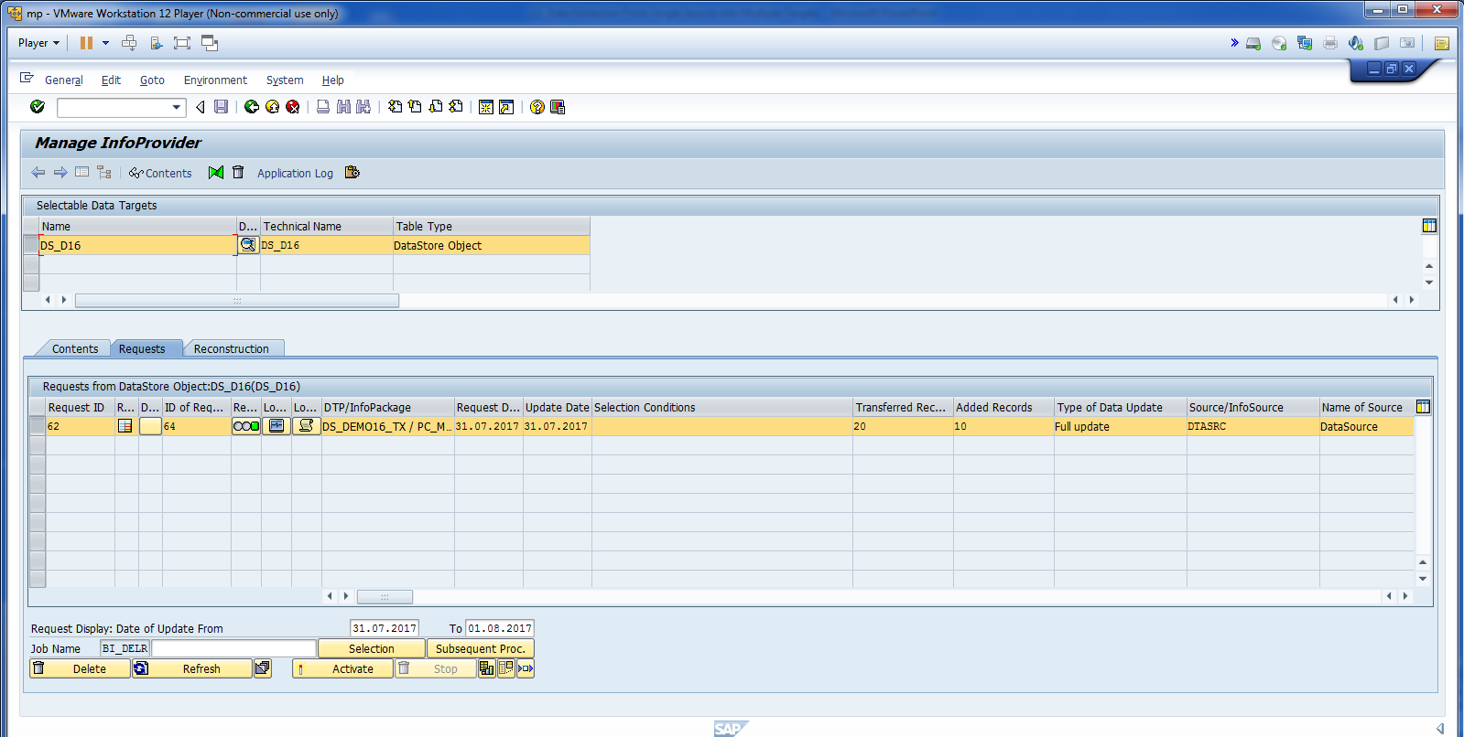
Data also loaded in DSO Successfully.

Slide 46
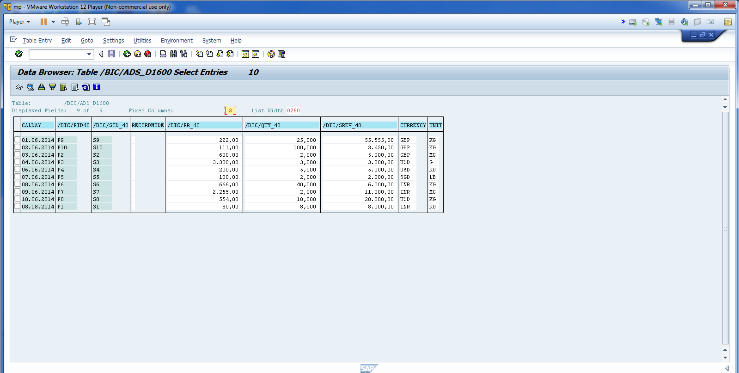
Data in Activate Table.

Slide 47
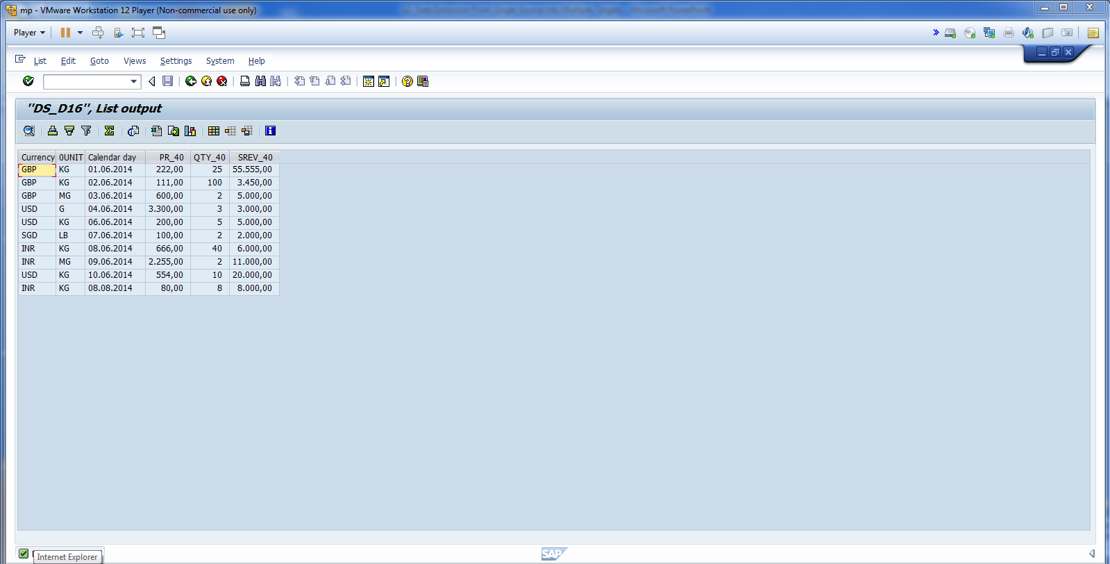
Data in DSO.

